Slide 1

GraphQL Primer
Key Concepts

Slide 2
Core Concepts and Advantages

Slide 3
Core Concepts and Advantages
A Brief history and motivation of GraphQL

Slide 4

The Genesis of GraphQL
Developed by Meta in 2012
Aimed to solve challenges of REST APIs
Motivated by need for more control of data fetching
Publicly released in 2015
Notes:
Introduction to GraphQL:
Developed by Meta, formerly known as Facebook, in 2012, GraphQL represents a significant evolution in how we interact with APIs.
It was designed from the ground up to address the challenges and limitations we frequently encountered with REST APIs.
Addressing REST API Limitations:
One of the main issues with REST was inefficiency in mobile environments, because of hardware limitations. Motivation Behind the Design:
The driving force behind developing GraphQL was the desire for more control over retrieving data.
This need for precise data retrieval is especially crucial
in applications that require high responsiveness and minimal data usage.
Public Release and Impact:
After several years of internal use and refinement, Meta publicly released GraphQL in 2015.
This not only demonstrated its proven effectiveness but also opened the door for other organizations to explore and adopt this technology,
significantly enriching the developer community's capabilities.

Slide 5

Why Not REST?
REST APIs often return fixed data structures.
Can degrade performance.
REST endpoints can proliferate.
Notes:
Introduction to REST Limitations:
While REST has been a foundational technology for web development,
it comes with inherent structural limitations that can be challenging,
especially as the complexity and scale of applications grow.
Fixed Data Structures:
One key issue with REST is that it typically returns fixed data structures.
This 'one-size-fits-all' approach often results in either too much or too little data being sent back. For example, whether you need just two fields or twenty,
the size of the response does not adjust to your actual query,
which can lead to increased load times and excessive data use.
Problems with Data Fetching:
This structure naturally leads to problems like under-fetching,
where the initial response doesn't provide all the data you need, requiring additional requests.
On the other hand, over-fetching happens when you receive more data than necessary. Both scenarios are inefficient and can significantly degrade application performance,
which is particularly problematic in mobile environments where resources are limited.
Proliferation of Endpoints:
Another significant challenge with REST is the proliferation of endpoints.
As the data needs of an application expand,
you often find yourself needing to manage an increasing number of endpoints.
This can create a complex and sprawling API surface that becomes difficult to maintain and evolve,
complicating further development and scaling.

Slide 6
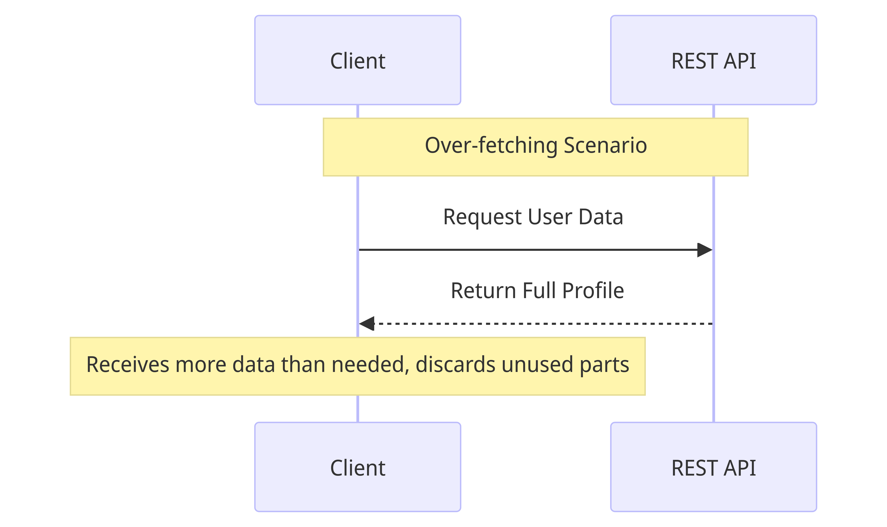
Over Fetching

Slide 7
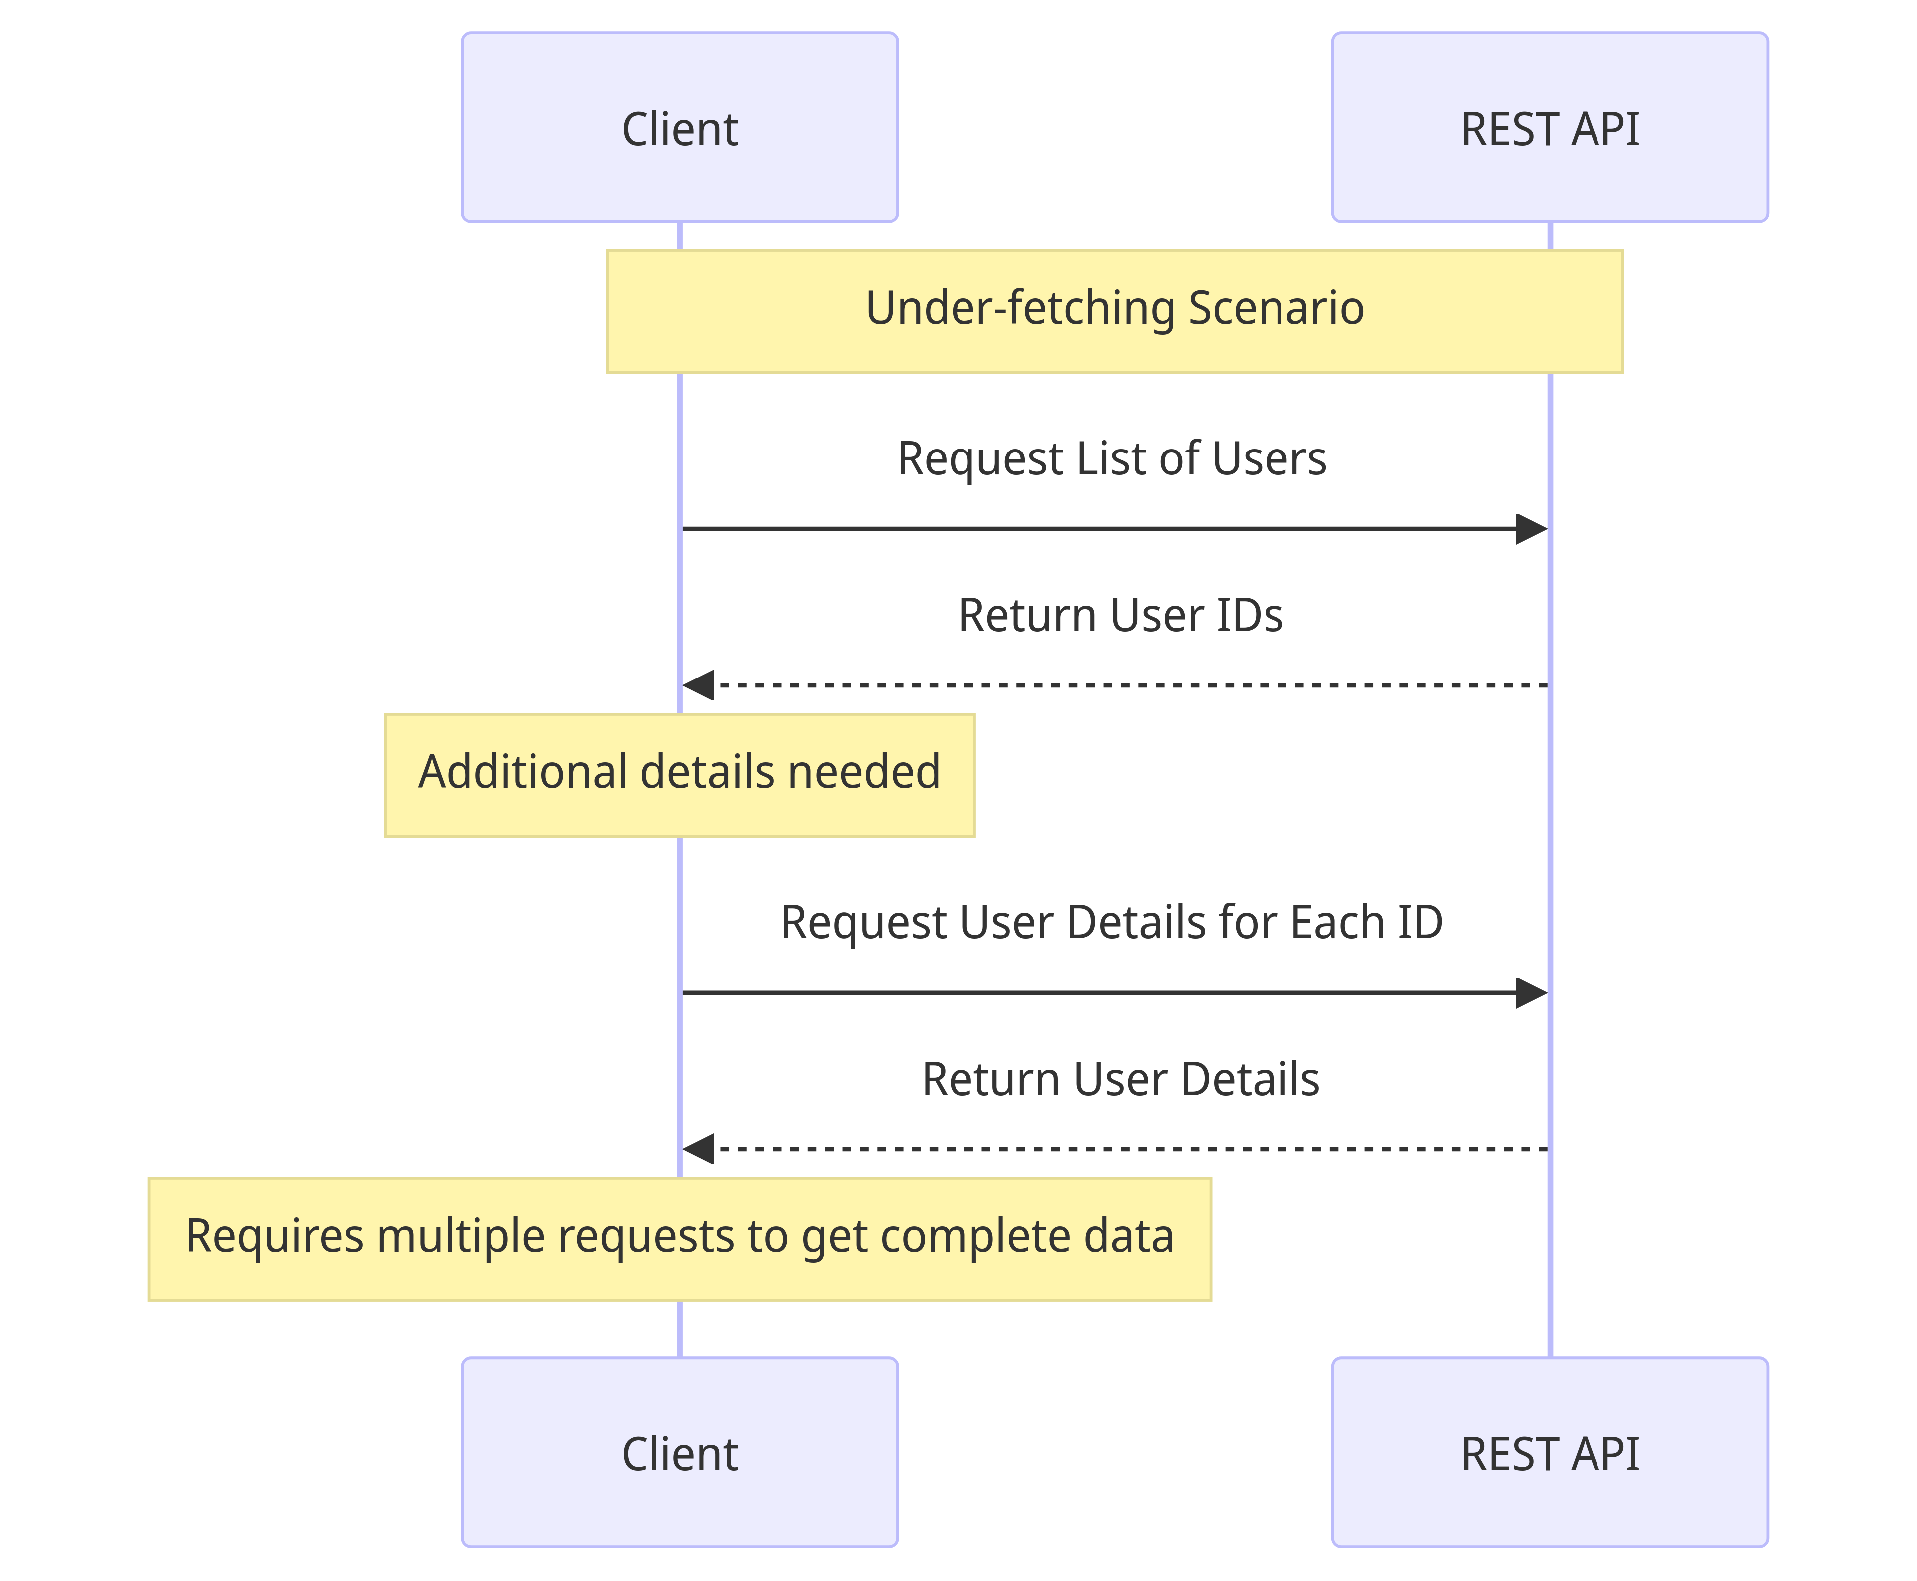
Under Fetching

Slide 8
The Core Motivations
Efficiency: Optimize data retrieval in a single request
Flexibility: Front-end can query for precisely what they need
Notes:
Introduction to Core Motivations:
GraphQL is fundamentally designed around two key motivations: Efficiency and Flexibility.
Efficiency:
Traditionally, fetching data might require multiple API calls to gather all necessary information,
which can significantly slow down an application and increase network load.
This is addressed by allowing a single, optimized request that retrieves everything needed at once.
This streamlined process enhances the application’s responsiveness and reduces bandwidth usage,
making it ideal for complex or mobile environments.
Flexibility:
One of the standout features of is the control it offers to front-end developers.
Instead of being limited by predefined data structures created on the backend,
developers can specify exactly what data they need.
This capability not only accelerates development times but also allows for more customized and dynamic application features, effectively removing the backend as a bottleneck in the development process.

Slide 9
GraphQL: A New Approach
Query language for APIs
Runtime for executing queries
Type system you define for your data
Notes:
Introduction to GraphQL's Innovations:
GraphQL introduces a new approach to API design and data management,
embodying several key innovations that overcome the constraints of traditional REST APIs.
Query Language for APIs:
Unlike REST, which often requires handling multiple endpoints, it provides a query language designed specifically for APIs.
This allows developers to explicitly specify exactly what data they need, eliminating inefficiencies such as over-fetching and under-fetching.
Runtime for Executing Queries:
It includes a runtime environment that processes queries.
This means that any data request is efficiently resolved and returned to the client,
no matter the complexity of the data or the diversity of the backend systems, including various types of databases and microservices.
This capability ensures that it can scale seamlessly across different platforms and data volumes.
Type System You Define for Your Data:
At the heart of GraphQL is a robust type system defined by developers.
This acts as a clear contract that governs the interactions between clients and servers.
It facilitates thorough data validation, improves API documentation, and supports introspection features.

Slide 10
GraphQL: A New Approach
Precise data fetching improves efficiency
Evolves your API without versions
Notes:
Allows Clients to Request Exactly What They Need:
By receiving precisely the data they request,
applications can optimize both performance and resource utilization, leading to faster and more efficient operations.
Evolves Your API Without Versions:
Unlike traditional APIs that often require versioning to accommodate changes—
resulting in multiple versions like v1, v2, and so on—GraphQL allows for the evolution of an API without the need for creating new versions.

Slide 11
Overview of GraphQL
Core Concepts and Advantages

Slide 12
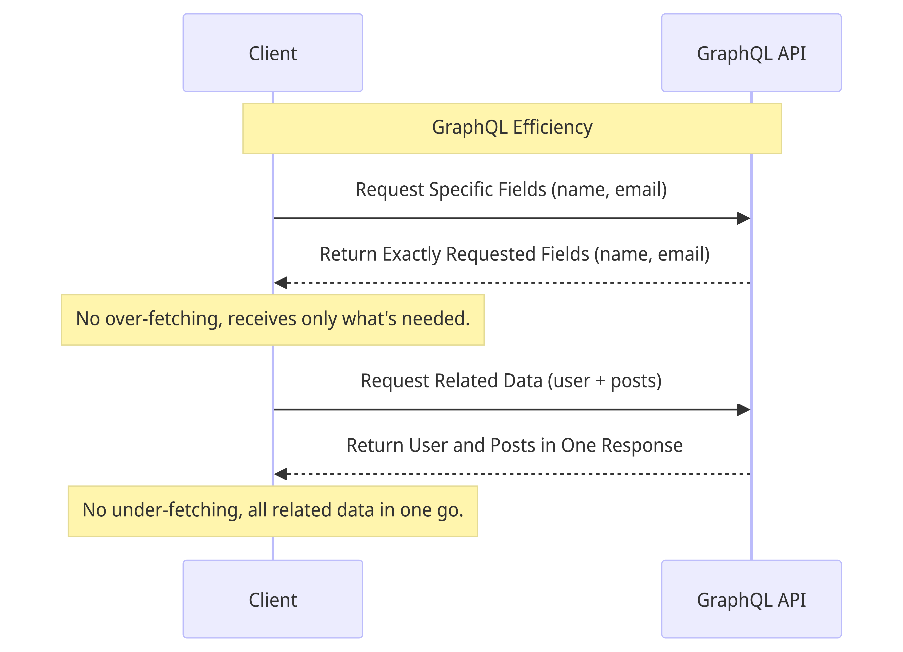
GraphQL Requests

Slide 13

Type Safety & Validation
Schema as a contract
Automatic Query Validation
Enables Advanced Tooling
Enhances Team Collaboration
Notes:
Introduction to GraphQL's Type Safety & Validation:
The type system and schema validation are foundational to its reliability and its developer-friendly nature.
These features enable more robust tooling and enhance team collaboration.
Schema as a Contract:
The schema functions as a contract between the client and server.
It clearly defines what queries are permissible and what data types should be returned.
This explicit agreement ensures a consistent and error-free structure for data interactions.
Automatic Query Validation:
Enhances the development process with automatic query validation.
Each query is checked against the schema before execution, ensuring compliance with the predefined data structure.
This validation step is crucial as it prevents errors early in the development cycle,
streamlining both development and maintenance tasks.
Enables Advanced Tooling:
Thanks to its strong typing and detailed schema specifications, GraphQL supports the development of sophisticated tools and IDEs.
These tools often include features such as auto-completion, real-time error feedback, and automatic documentation generation.
Such capabilities significantly boost developer productivity and streamline the coding process.
Enhances Team Collaboration:
The clarity provided by these well-defined schema greatly facilitates team collaboration.
Front-end developers can easily understand what data is available and how to effectively query it without repeatedly consulting back-end team members.
This level of clarity not only speeds up the development process but also promotes a more agile and efficient project environment.

Slide 14

Performance Optimizations
Advanced Request Handling
Caching Mechanisms
Query Optimization
Notes:
Introduction to Performance Optimizations:
GraphQL significantly transforms application performance through its sophisticated approach to handling requests,
employing comprehensive caching mechanisms, and optimizing queries.
Advanced Request Handling:
At the forefront of its performance enhancements is its advanced request handling.
Supports query batching and merging, reducing the necessity for multiple server requests.
Caching Mechanisms:
Caching is a critical aspect of the performance strategy.
It implements effective caching on both the client-side, which stores previously fetched data,
and on the server-side, which reuses response data for similar queries.
This dual-layered caching approach lessens the workload on servers and decreases data transmission needs,
leading to faster and more responsive applications.
Query Optimization:
Furthermore, it offers extensive tools and guidelines for query optimization.
It incorporates measures to limit query depth and complexity, helping to avert potential performance issues.
By ensuring queries are executed in the most efficient way possible,
It protects server resources and delivers a seamless user experience.

Slide 15
Real-time Interactions
Instantaneous Updates with Subscriptions
Versatile Applications
Dynamic User Experience
Efficient and Scalable
Notes:
Real-time interactions are done through its subscription mechanism.

Slide 16

Developer Experience
Intuitive Query Language
Powerful Dev Tools
Real-time Feedback & Documentation
Community support
Notes:
Overview of Developer Experience Enhancements:
It significantly elevates the developer experience.
Intuitive Query Language:
The design of the query language is inherently intuitive, closely mirroring the structure of the returned data.
This close correspondence makes it easy for developers to understand and predict the outcomes of their queries,
streamlining the learning curve and increasing efficiency in building data-driven applications.
Powerful Developer Tools:
Within the GraphQL ecosystem, there are numerous powerful tools that significantly aid development.
Tools like GraphiQL, an in-browser IDE, and Apollo Studio enhance productivity through features such as sophisticated query building, debugging, and performance monitoring.
Real-time Feedback and Documentation:
GraphQL enhances development workflows by providing real-time feedback on queries through detailed error messages.
Additionally, it supports auto-generated, always-up-to-date documentation based on the schema.
This dynamic documentation system reduces the need for manual updates and minimizes the trial-and-error often associated with API development,
allowing for quicker iterations and more reliable integration.
Community Support:
Lastly, the community around GraphQL is a cornerstone of its success.

Slide 17
GraphQL Under the Hood

Slide 18
GraphQL Under the Hood
Schema Definition and Operations

Slide 19
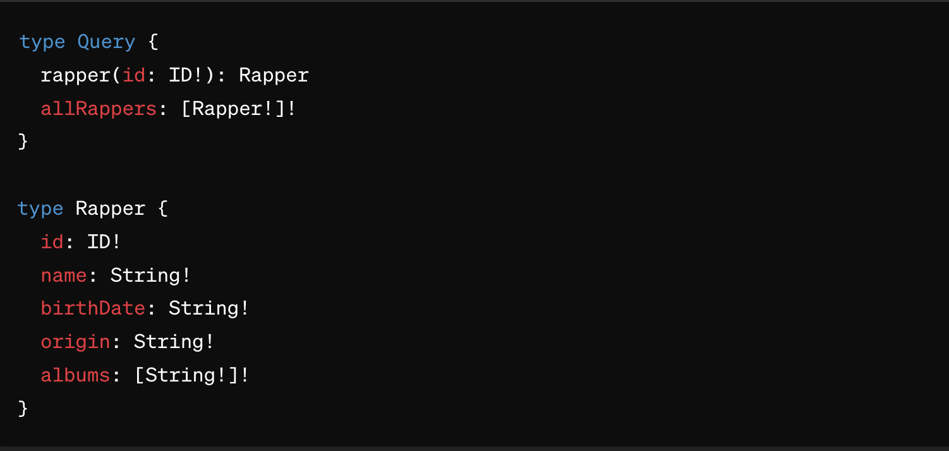
GraphQL Schemas
Schema as a Contract
Schema Definition Language(SDL)
Notes:
Introduction to GraphQL Schemas:
Schemas are foundational to how its APIs function.
Schema as a Contract:
The schema serves as a binding contract between the client and the server. It defines precisely what queries,
mutations – operations to make changes to data, and what data structures will be returned.
This contract ensures that both sides have a clear understanding and agreement on the data exchange,
leading to fewer errors and a more predictable application behavior.
Schema Definition Language (SDL):
SDL is the syntax used to define a GraphQL schema.
It is designed to be easy to read and write, allowing developers to quickly define types, fields, and other schema elements.
SDL makes it straightforward to articulate the schema's capabilities and constraints,
providing a blueprint that helps developers build and evolve the API.

Slide 20
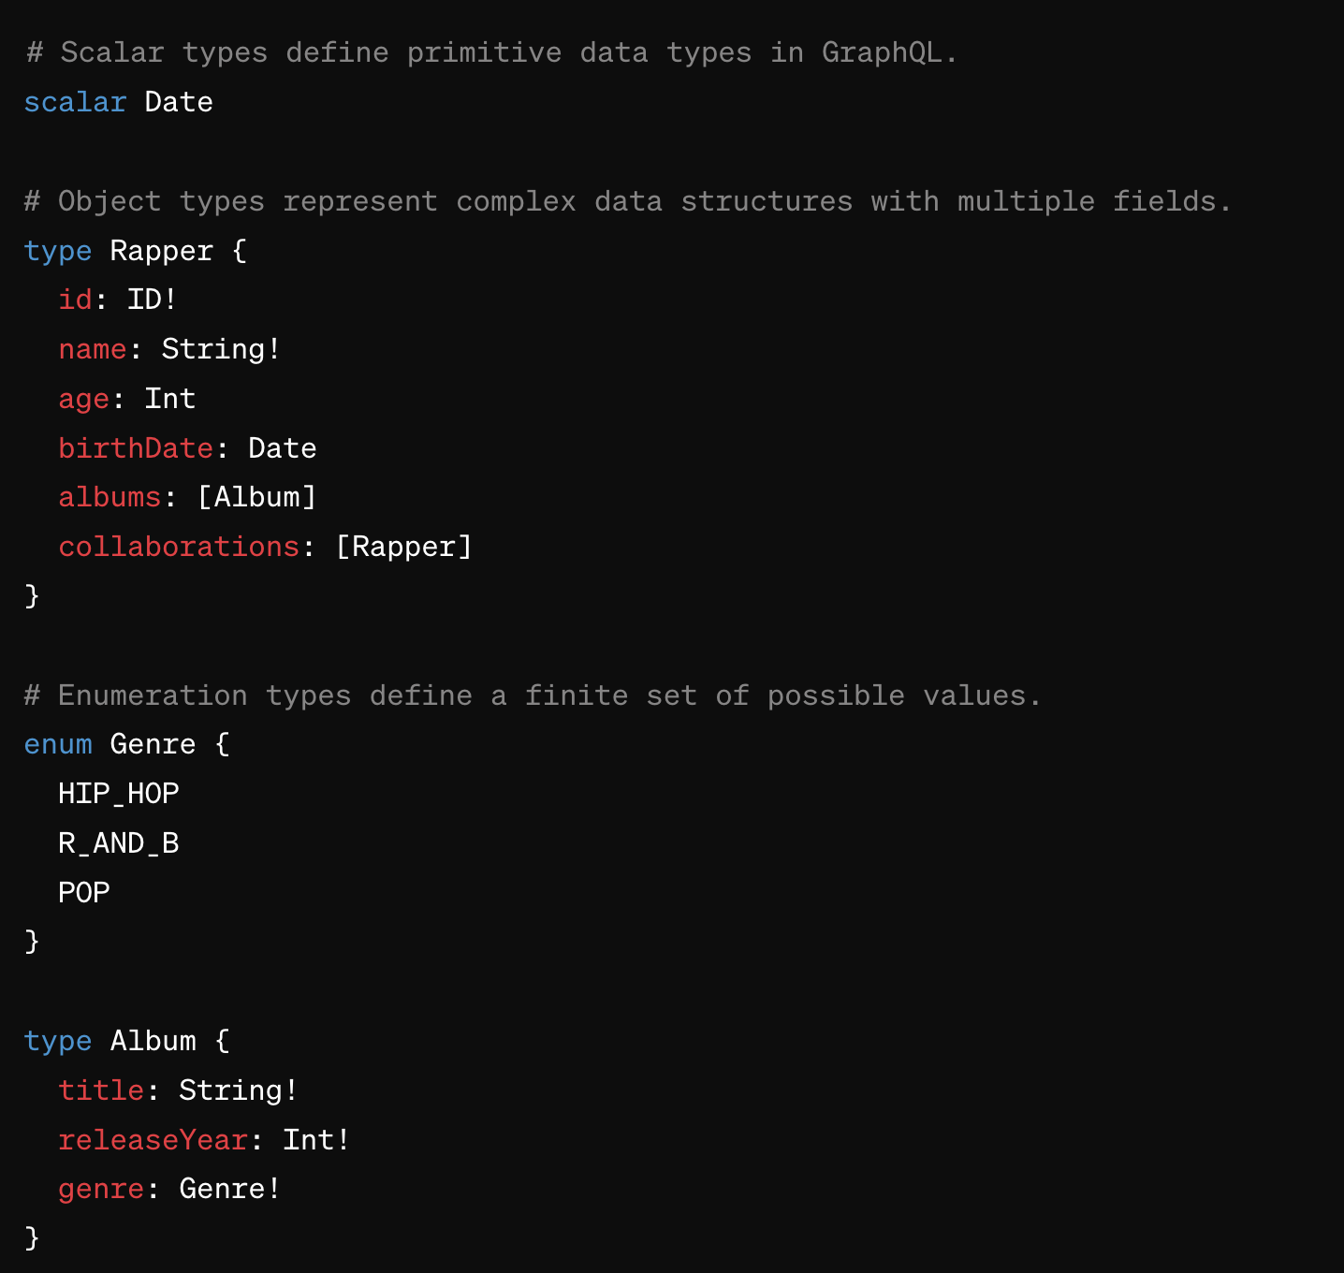
Defining Types in GraphQL
Scalar
Object
Enumeration
Notes:
Introduction to Types in GraphQL:
Types are the fundamental building blocks of a GraphQL schema,
structuring how data can be accessed and manipulated through the API.
Scalar Types:
Scalar types represent the most basic data types.
These include String, Int, Float, Boolean, and ID.
Scalars are used to define the shape of the data returns in responses,
and they ensure that each field adheres to a specific datatype, providing consistency across your API.
Object Types:
Object types are composite types that allow you to represent more complex data structures.
Each object type defines a list of fields, where each field is named and typed.
These fields can themselves be Scalar types, Object types, or even Arrays of types.
Object types are crucial for modeling relationships and hierarchies in your data,
making it powerful for querying deeply nested information.
Enumeration Types:
Enumeration types, or Enums, let you define a field that can only have one of a limited set of values.
This is particularly useful for fields that should conform to a specific set of options, such as statuses, roles, or categorical labels.
Enums help enforce data validation directly within the schema.

Slide 21
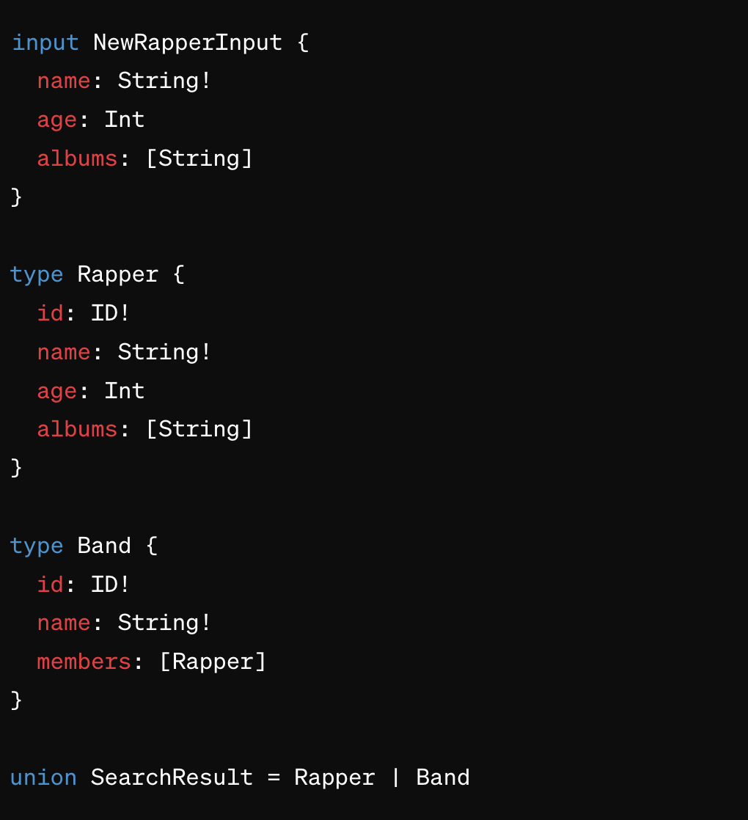
Defining Types in GraphQL
Input
Union
Lists
Non-null
Notes:
Input Types:
Input types are special kinds of object types that allow you to pass complex objects as arguments to GraphQL mutations.
They are defined in the schema and specify the shape of data that can be input into a query.
Union Types:
Union types allows a field to return one of a defined set of types.
This is especially useful when a query could return objects that don't necessarily have fields in common, for instance,
searching for items that could be either books or music albums, each with their distinct properties.
Lists and Non-null:
Lists and Non-null types address the collection and requirement aspects of data.
A List type, indicated by square brackets, allows a field to contain an array of another type, and you can use it to define a collection of items.
The Non-null type, denoted by an exclamation mark, ensures that a field never returns a null value,
which is crucial for fields that must always have data, like a user ID or an item price.

Slide 22
Queries
Queries retrieve data
Define the data structure to fetch
Provide flexibility in data retrieval
Notes:
Introduction to Queries in GraphQL: Queries are at the core of GraphQL's data retrieval capabilities.
Client-Driven Structure:
Contrary to REST APIs, where the server dictates the data returned through fixed endpoints,
Queries put the power in the hands of clients.
Tailored Data Retrieval:
Queries aren't just about retrieving data; they offer clients the flexibility to tailor requests.
This includes nuanced requirements such as filtering results, paginating through datasets,
and sorting data in a specific order—features that are intrinsic to modern web applications.

Slide 23
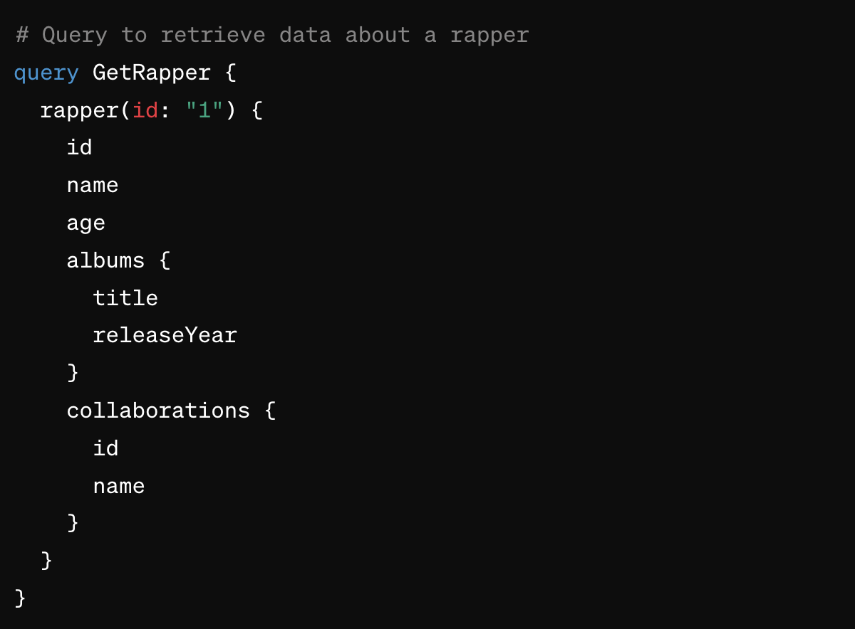
Queries
Notes:
GraphQL Query Example:
We're querying a API to retrieve detailed information about a rapper by their ID.
Specificity of Queries:
Notice how the query is named GetRapper,
which is a best practice for easily identifying the purpose of the query.
We’re asking for a specific rapper with the ID '1'. The fields within the rapper query are selectively chosen to return only the information we need,
such as their id, name, age, and details about their albums and collaborations.
Structured Data Retrieval: Within the albums and collaborations,
we are not retrieving all the details but just the title and releaseYear for albums,
and the id and name for collaborations. This structure allows front-end developers to display a rich set of information without making additional requests or receiving extraneous data.
Advantages of GraphQL Queries:
This query exemplifies GraphQL's ability to reduce over-fetching and under-fetching, as the client has full control over the queried data.
It also demonstrates how relationships between data points, such as albums and collaborations, can be easily navigated within a single request.

Slide 24
Mutations
Modify or create data
In REST, equivalent to:
POST
PUT
PATCH
DELETE
Used for actions like: adding, updating, or deleting
Notes:
Introduction to Mutations in GraphQL: Mutations are a type of operation that allows clients to modify or create data.
They play a crucial role in making GraphQL a complete API standard, capable of handling not just data retrieval but also data manipulation.
Comparison with REST Methods: In the context of REST, mutations correspond to several HTTP methods used for various data modifications.
These include POST for creating new resources, PUT and PATCH for updating existing resources, and DELETE for removing them.
Use Cases for Mutations: Practical use cases for mutations are plentiful.
They are employed for a wide range of data-manipulation actions, such as adding a new user profile, updating a blog post's content,
or deleting a transaction record.
Each mutation clearly specifies the operation to be performed and is designed to ensure that clients can directly manipulate data in a controlled and secure manner.
Ensuring Data Integrity: Mutations also provide a mechanism to ensure that changes to data are executed sequentially on the server, maintaining data integrity.
Unlike queries, which can be run in parallel, mutations are executed one after the other, which is important for operations that depend on the current state of the data.

Slide 25
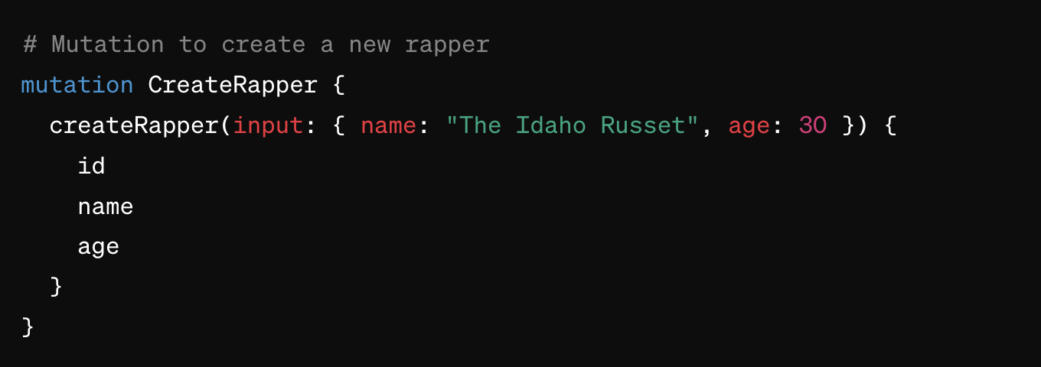
Mutations
Notes:
Structure of the Mutation:
The mutation is named CreateRapper, which clearly indicates its purpose.
We define the mutation with the createRapper field,
passing an input object with predefined fields like name and age.
These fields are the minimum data required to create a new rapper record.
Input Object Usage:
The input in the mutation encapsulates the data we want to send to the server.
It's a common pattern in GraphQL to use an input type to handle complex arguments when you need to pass several fields together,
as it maintains a clear and organized structure.
Response Selection:
After the new rapper is created,
we're asking the mutation to return the id, name, and age of the newly created rapper. This is the data we’ve deemed important to receive back immediately after the creation operation for potential further use,
like updating the UI or confirming the action was successful.

Slide 26
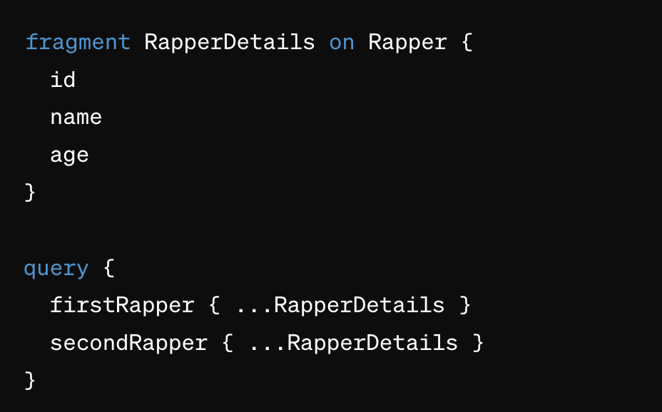
Fragments
Enable reusable query logic
Improves
Organization
Readability
Notes:
Introduction to Fragments:
Fragments are essential for creating reusable and maintainable query logic.
They simplify complex queries by encapsulating field sets.
Reusable Query Logic:
By defining a fragment, you create a modular chunk of query logic.
This is especially beneficial when the same group of fields is needed in multiple queries.
Enhancing Readability and Organization:
In addition to promoting reuse, fragments inherently make your queries more readable and better organized.
With descriptive names, they serve as self-documenting elements within your codebase, making it easier for developers to navigate and understand.
Example of Fragment Usage:
In the provided code example, we see a fragment named RapperDetails.
This fragment is then applied to two separate queries, firstRapper and secondRapper, by referencing ...RapperDetails,
eliminating the need to repeat the field definitions for each rapper query.

Slide 27
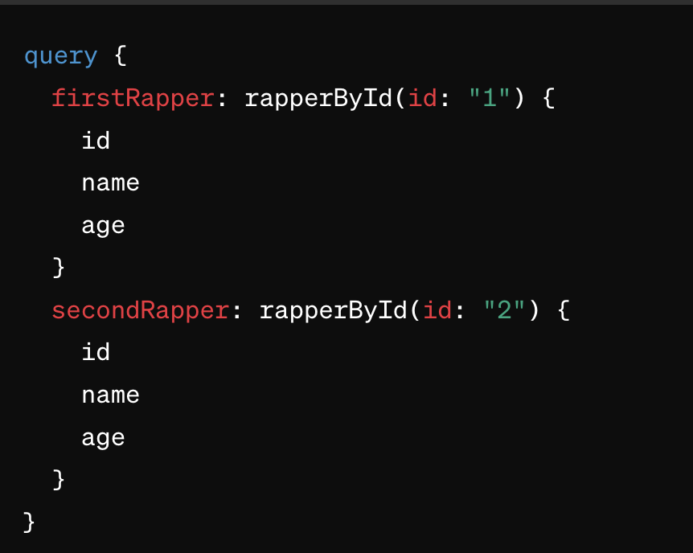
Aliases
Renames result of a field
Useful for:
Making results more readable
Avoiding naming conflicts
Same field with different args
Notes:
Introduction to Aliases in GraphQL:
Aliases are simple yet powerful: they allow us to rename the result of a field in a query.
Renaming for Clarity:
Aliases provide clarity by renaming field results to more descriptive terms, making the data more accessible and meaningful at a glance.
Resolving Naming Conflicts:
When querying fields that may have the same name or when using the same field multiple times with different arguments, aliases are the solution.
They avoid confusion in the query's results by ensuring each field result has a unique identifier.
Querying with Different Arguments:
Using aliases allows us to execute queries on the same field with varying arguments,
and neatly separate the results within the same query response.
This capability is key for fetching diverse data in one go without losing the clarity of which result corresponds to which query condition.

Slide 28
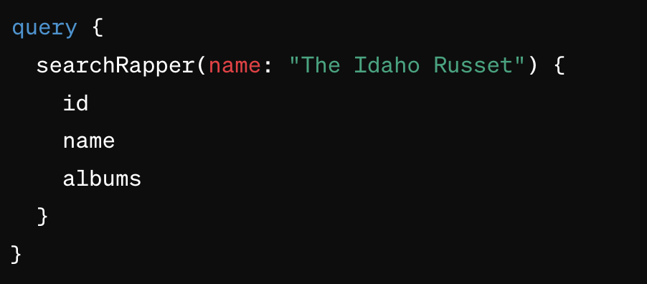
Arguments
Customizes Queries
Enhanced Flexibility
Notes:
Introduction to Arguments:
Arguments allow us to customize queries, providing the enhanced flexibility needed to retrieve specific data.
They act much like function arguments, modifying the execution of a query or mutation.
Customizes Queries:
With arguments, you can pass in values that refine your query results.
For example, you could search for a rapper by name, filter albums by release date, or paginate through a list of songs.
Enhanced Flexibility:
Arguments can be used to sort, filter, and shape the data exactly how the client needs,
often in complex and dynamic ways.
Code Example:
In the displayed query, searchRapper takes a name argument to look for a specific rapper.
This allows the client to directly ask for the id, name, and related albums of 'The Idaho Russet', demonstrating a targeted and efficient data fetch.

Slide 29
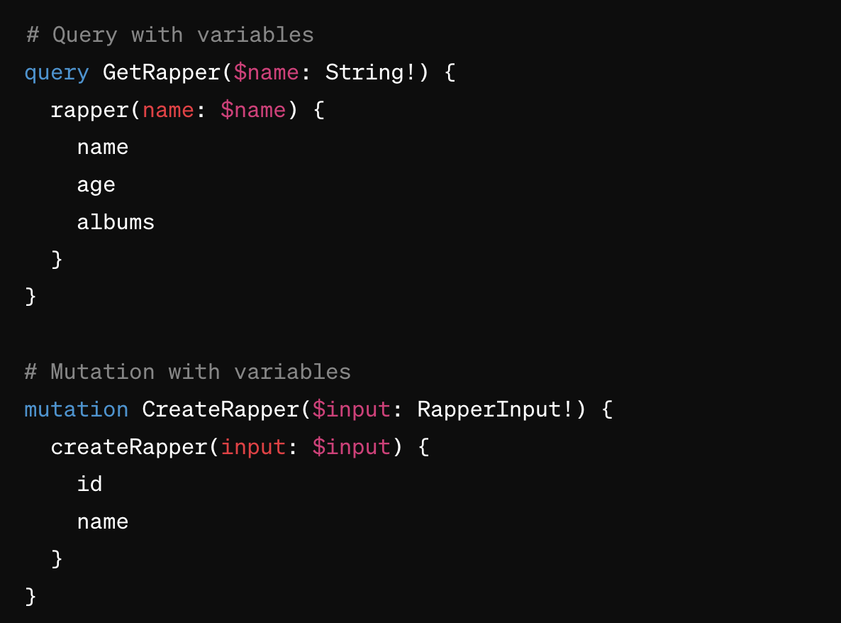
Variables in Queries & Mutations
Enables Dynamic Operations
Use Types
Notes:
Introduction to Variables:
Variables are key to maximizing the dynamism of GraphQL, allowing operations to be reused in various contexts.
They are defined with specific types to maintain consistency within the data flow.
Enabling Dynamic Operations:
By integrating variables into queries and mutations, operations become dynamic.
Defining Variable Types:
Variable types must be specified to ensure the type safety of your API.
This enforces a contract for the data that can be sent and received, much like the schema does for the overall API.
Usage in Queries and Mutations:
Variables are used within queries and mutations by first declaring them in the operation signature with their respective types.
When executing the operation, actual values for these variables are provided.

Slide 30
Directives in Operations
Dynamic Query Behavior
Common Directives: @include @skip
Custom Directives
Notes:
Dynamic Query Behavior:
With directives such as @include and @skip, you can control which parts of a query are executed, based on variables.
This allows a single query to serve multiple purposes, fetching different sets of data when conditions change.
Common Directives:
The @include directive lets you conditionally include fields in your result, while @skip allows you to omit fields based on a condition, typically tied to a variable.
These directives make your queries adaptable to context, such as user permissions or feature toggles.
Custom Directives:
You canalso define custom directives, opening up possibilities for integrating your business logic into your schema.

Slide 31
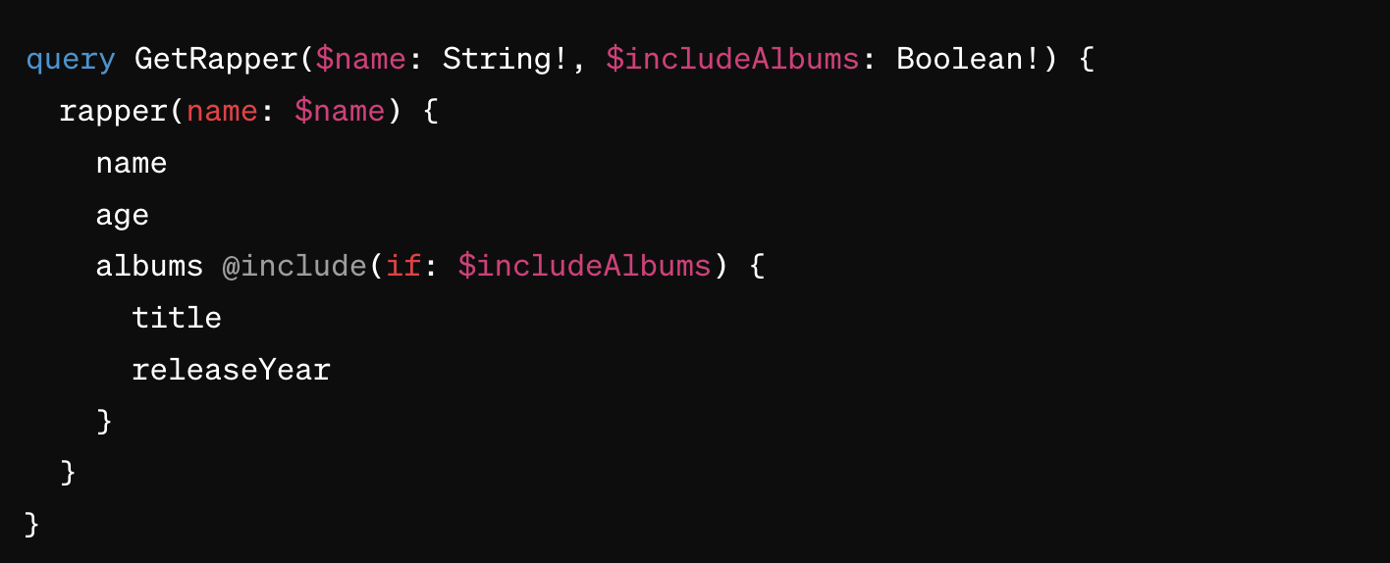
Directives in Operations: @include
Notes:
Using the @include Directive:
When this variable is true, the albums field and its subfields title and releaseYear will be included in the response.

Slide 32
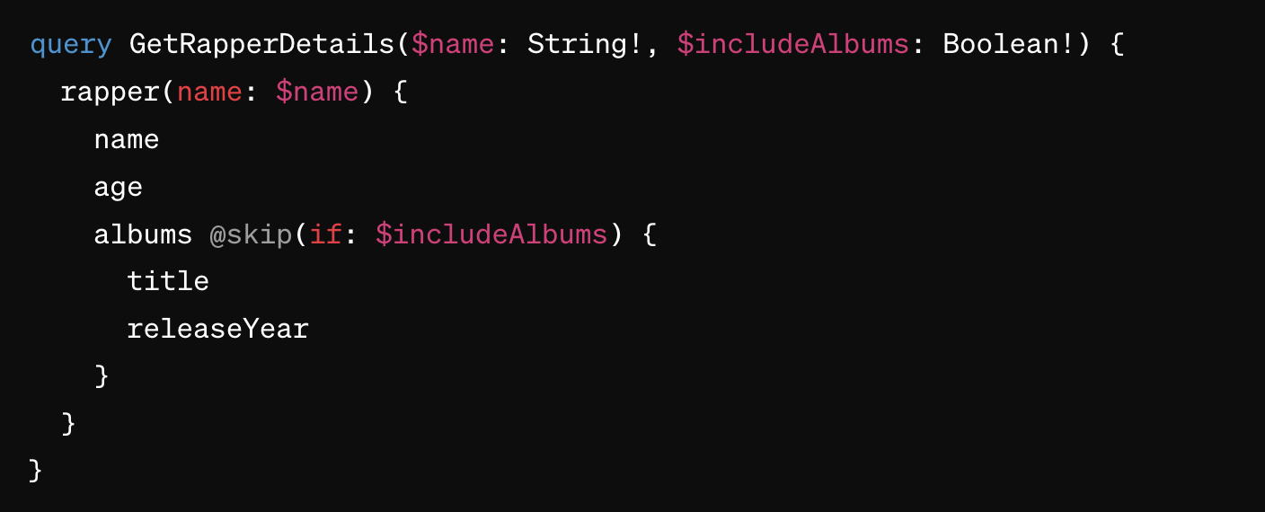
Directives in Operations: @skip
Notes:
@skip Directive:
In contrast, this query shows the @skip directive in action. If $includeAlbums is true, the albums field will be skipped and not appear in the result.
The flexibility provided here allows clients to exclude information they may deem non-essential or sensitive, depending on the context of the request.

Slide 33
Error Handling
Error Reporting in Responses
Structured Error Format
Partial Data with Errors Can return both error information & requested data
Notes:
Introduction to Error Handling in GraphQL:
Error handling is integral to GraphQL's design, offering developers clear insights within the response itself.
Unlike REST APIs, which use HTTP status codes as the primary error signaling mechanism, it includes detailed error information alongside the actual data.
Error Reporting in Responses:
When an error occurs in GraphQL, it doesn't completely halt the response.
Instead, errors are reported in the same payload as the data, under an errors field.
This ensures that any successful part of the request is still delivered to the client.
Structured Error Format:
Errors are structured objects, not just error strings.
This structure typically includes a message,
a list of locations in the query that led to the error, and an optional field for additional error details.
Partial Data with Errors:
One of GraphQL's strengths is its capability to return partial data even when some fields fail to resolve.
This allows the application to use the correctly fetched data while dealing with specific errors,
thereby improving the user experience and application resilience.
This approach to error handling is designed to provide as much useful information as possible,
both for developers debugging issues and for client applications to handle errors gracefully.
Making it robust and user-centric of error management.

Slide 34
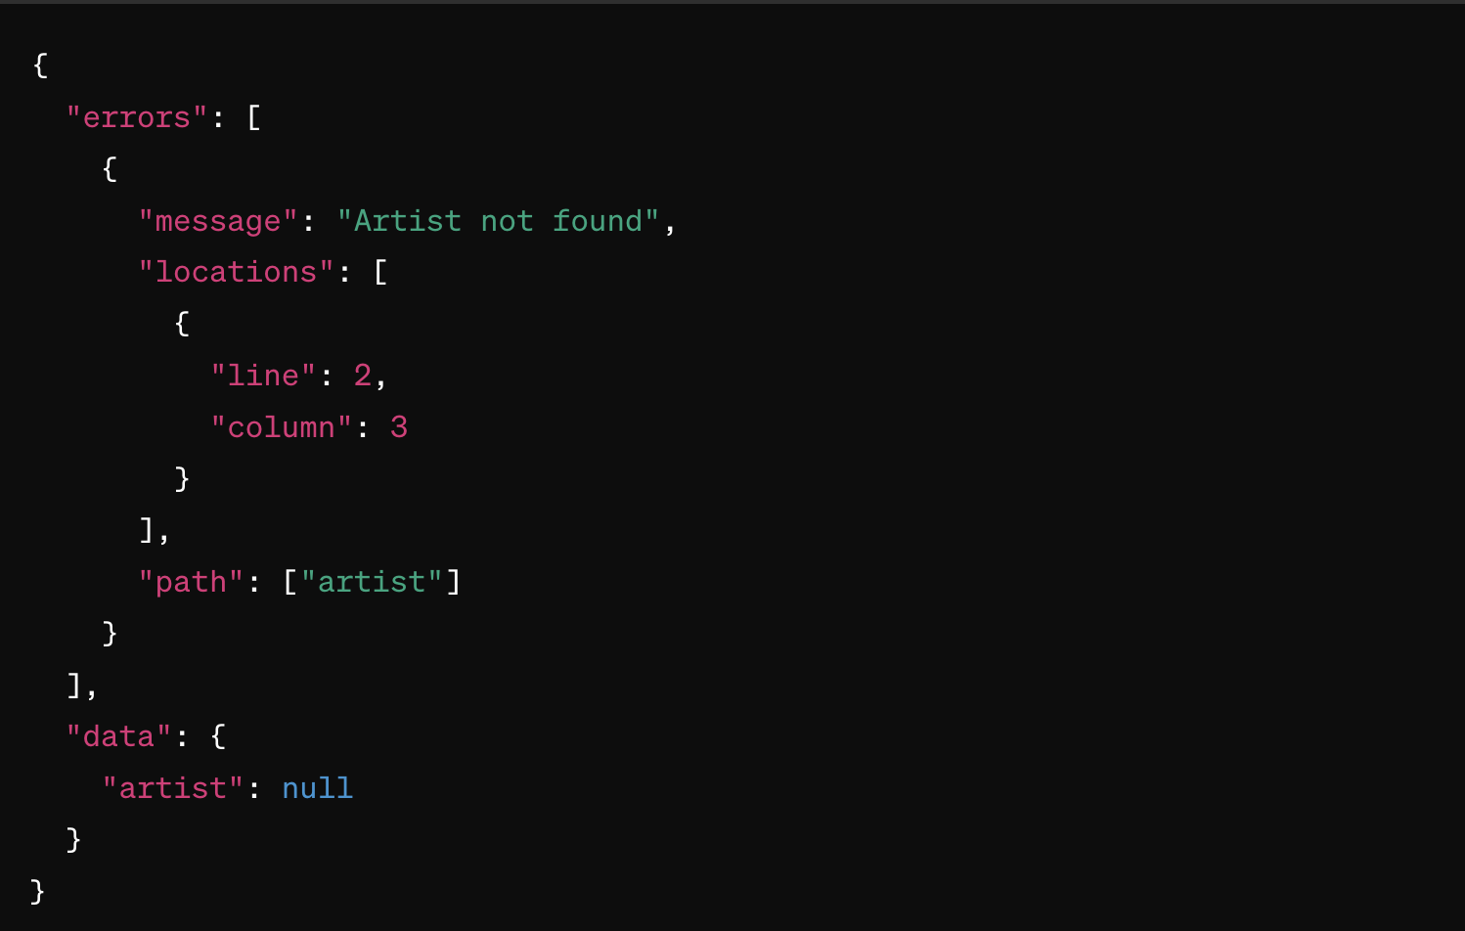
Error Handling
Notes:
Understanding the Error Response:
This response illustrates GraphQL's error handling in action.
Notice the structure of the response: it contains an errors array and a data field.
This demonstrates GraphQL's ability to return both errors and data in the same response.
The error object provides a clear message indicating what went wrong, in this case, 'Artist not found'. Additionally, it specifies the locations with line and column information,
pinpointing where in the query the error occurred, and the path to the field that caused the error.
Partial Data and Nullability:
In the data part of the response, we see that the artist field returns null.

Slide 35
GraphQL Under the Hood
A Brief overview of Resolvers

Slide 36
Data and Resolvers
Resolvers Connect Types to Data
Fetch the data per field
Like schema types to data sources
Role of Resolvers in Query Execution
Triggered by field access in queries/mutations
Fetch from any data source
Resolver Signature
Parameters include: parent results, input arguments, context, and query info
Notes:
Introduction to Resolvers:
Resolvers are the engines under the hood. They are functions that resolve individual fields in a query.
Think of them as the bridge connecting your schema — the types and fields — to the actual data they represent.
Resolvers Connect Types to Data:
Each field in a schema is associated with a type, and each type is associated with a resolver.
These resolvers determine how to fetch the data for their respective fields, whether it’s from a database, a microservice, or a third-party API.
Role of Resolvers in Query Execution:
When a query or mutation comes in, it’s the resolvers’ job to execute.
They're triggered as processes each field, working in a nested manner that corresponds to the structure of the query.
Resolver Signature:
Resolvers have a specific signature.
They receive four arguments:
the parent result, which provides the result from the previous resolver execution,
the args, which are the input arguments from the query,
the context, which is a global object passed throughout each resolver call, and
the info object, which contains information about the execution state of the query.

Slide 37
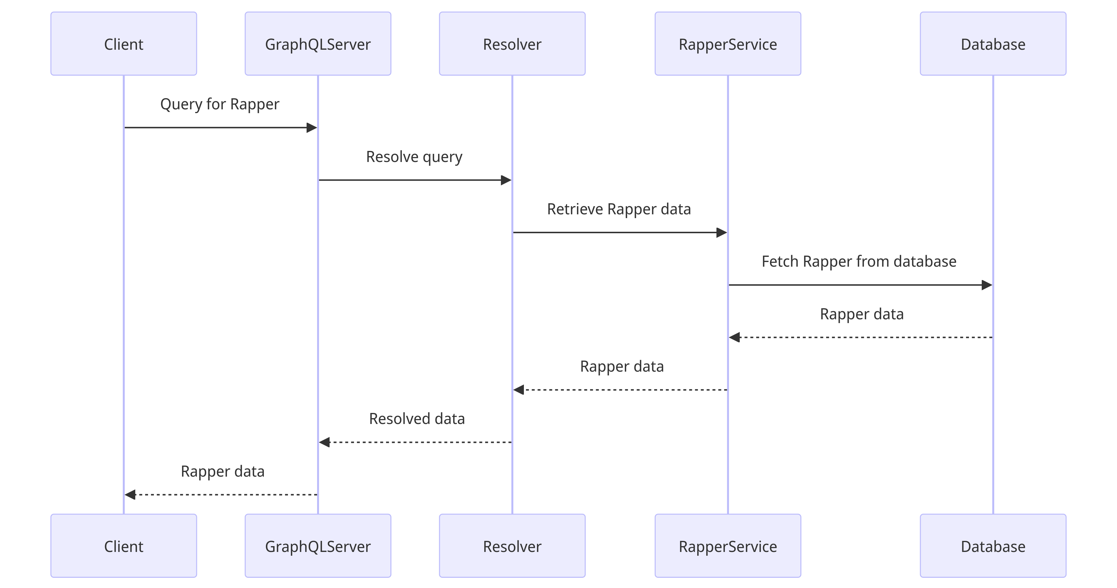
Data and Resolvers

Slide 38
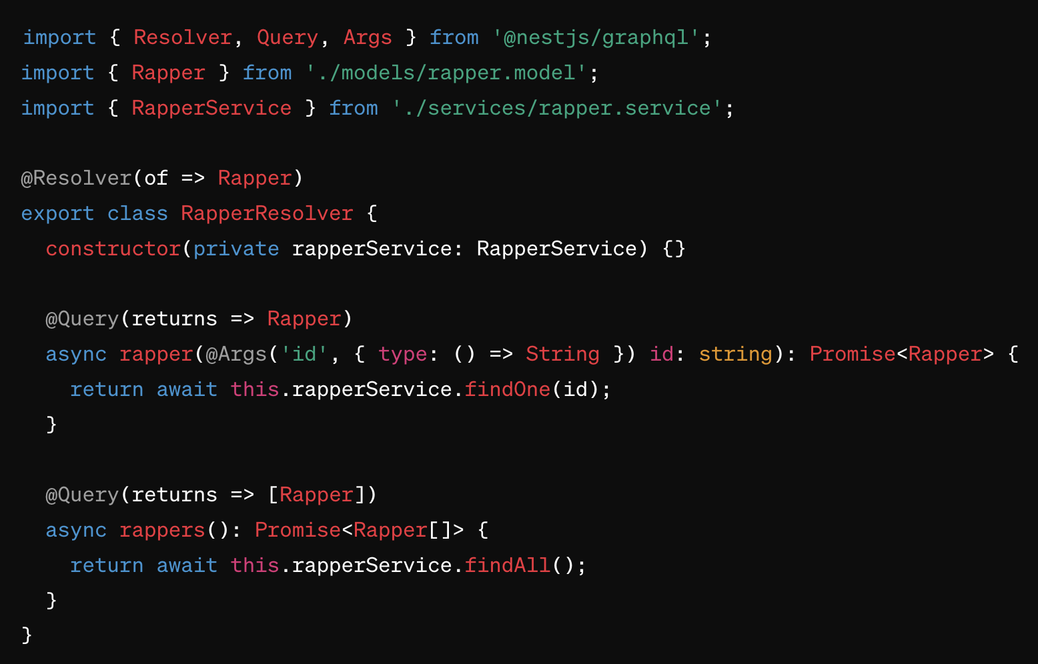
Data Retrieval with Resolvers
Notes:
Resolver Functionality:
Here we have two resolver functions defined within our RapperResolver class.
The first function, rapper, retrieves data for a single rapper based on an ID. The second function, rappers, fetches an array of all rappers.
Each function uses the rapperService to communicate with the database, demonstrating how resolvers translate from GraphQL queries to actual data retrieval operations.

Slide 39
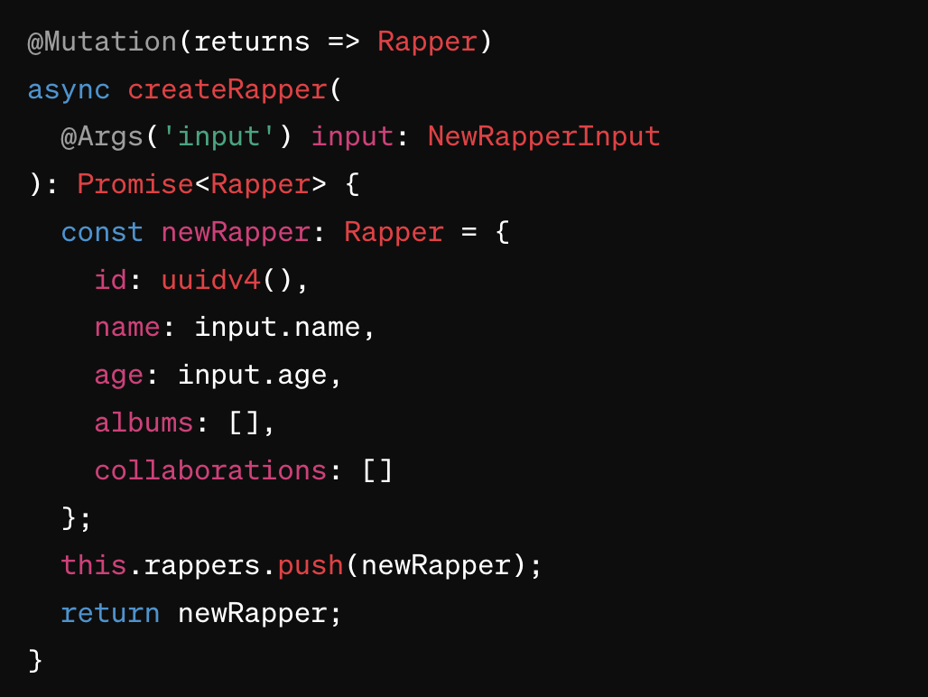
Data Modification with Resolvers
Notes:
Mutation Resolver for Data Creation:
Here we have a resolver function designed for a mutation. It's responsible for creating a new rapper entity in our system.
The createRapper mutation takes a NewRapperInput type,
which contains the new rapper's details.
It then creates a newRapper object, assigns it a unique ID, and includes the input data.
Finally, it adds the new rapper to our data store and returns the newly created rapper object.

Slide 40
Interactive Lab: Launching Uncle Rico's Game Emporium

Slide 41
Interactive Lab
Set up

Slide 42
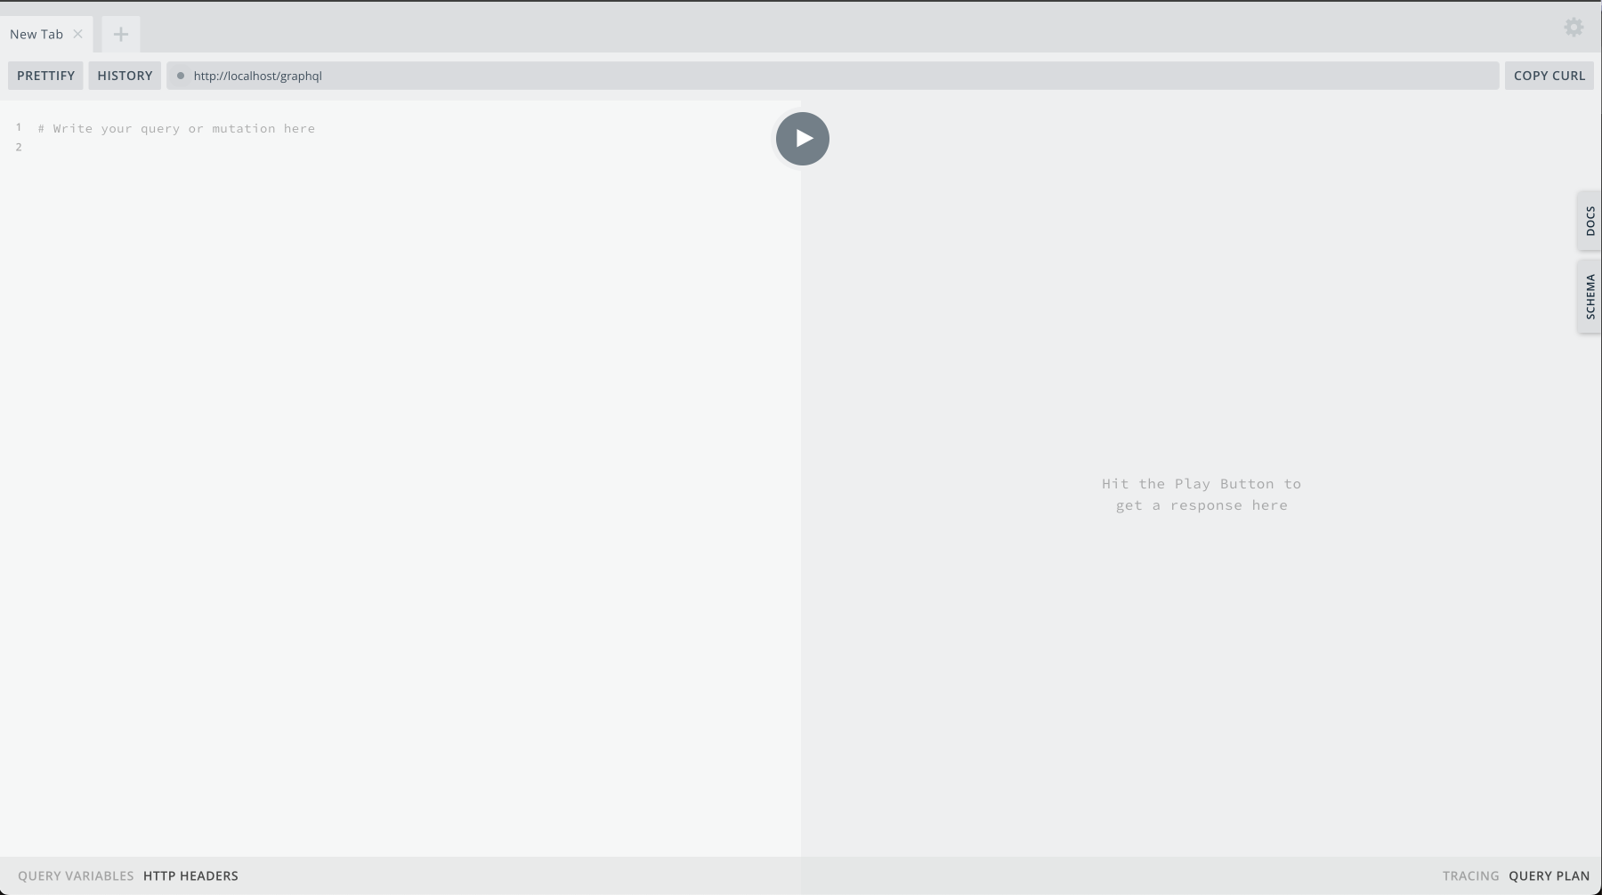
Set up
npm install
npm run start:dev
http://localhost/graphql

Slide 43
Interactive Lab
Setting the scene

Slide 44

Uncle Rico's Gaming Alcove
Notes:
Uncle Rico's store, a well-known local spot, was more than just a place to buy games—it was a portal to the past.
Visitors found themselves immersed in a collection that not only brought back memories but also celebrated the enduring joy of gaming experienced during childhood.
Balancing Nostalgia with Innovation:
Rico was a pioneer who appreciated the charm of classic gaming while eagerly exploring new technological advances.
His vision was clear:
to share this rich blend of past and present with a broader audience, ensuring that the appreciation for both physical and digital gaming formats continued to thrive.
Continuing a Tradition of Gaming Excellence:
Engaging with Rico's collection is not by chance—it's an active choice to connect with the history of gaming.
This endeavor goes beyond mere commerce; it is about preserving and enhancing a community built on shared experiences and a love for gaming's classic era.

Slide 45
The Transition To Digital
Project Objective
Digitizing a cherished retro game collection
Why GraphQL?
Tailored data retrieval
Streamlined interactions
Dynamic data exploration
Notes:
Project Objective:
Our primary goal is to digitize Uncle Rico’s treasure trove of retro games.
It’s a tribute to the past and a bridge to the future, leveraging digital tools to preserve and enliven these gaming relics for enthusiasts worldwide.
Why GraphQL?
GraphQL is our chosen technology because it epitomizes the art of specific and efficient data delivery.
It allows us to provide personalized experiences for our users, enabling them to uncover their nostalgic desires quickly and easily.
The Transition to Digital – Why Now?
The digital leap is not just a step forward; it’s a necessity rooted in our duty to carry on Uncle Rico’s passion.
In an age where the digital is omnipresent, we embrace it to keep the culture and the community around these games vibrant and accessible.
Choosing GraphQL:
Opting for GraphQL was a strategic decision.
Its flexibility in data retrieval means our users won't wade through irrelevant information.
They’ll directly access the games that matter to them, reflecting our commitment to a user-centered service.

Slide 46

Our Roles & Goals
Roles
Data Explorers
Query Architects
Goals
Become proficient
Retrieve with ease
Notes:
Defining Our Roles:
Our team takes on two primary roles: Data Explorers and Query Architects.
As Data Explorers, we navigate through our digitalized collection, using GraphQL to understand the vast array of games we offer.
Query Architects are the designers of our data-fetching strategies, crafting precise queries that meet our user's needs.
Objectives for Our Roles:
Our aim is to become adept with GraphQL, turning complex data landscapes into user-friendly information.
We focus on proficiency, ensuring that even the most intricate queries become effortless for us to construct and execute.
Goals for Mastery:
The end goal is ease of data retrieval.
We want every team member to retrieve any piece of data with confidence and speed.
It’s about making the complex simple and the inaccessible, reachable.

Slide 47
Interactive Lab
Working with GraphQL
Notes:
Interactive Lab Tasks
Review Playground
Docs
Schemas
Basic Query
Naming Your Query
Two Queries - Aliases
Fragments for re-usabability
Arguments
Mutations
Mutation Operations
Create
Update
Delete
Variables
Directives?

Slide 48
Closing Remarks

Slide 49
Recap
Core Concepts and Advantages
Understanding GraphQL
Interactive Lab

Slide 50

Q&A
Notes:
Opening Remarks for Q&A:
I want to express my gratitude for your engagement and insightful contributions throughout this session.
Now, we have the opportunity to delve deeper into any queries you might have.
Encouraging Participation:
This is the perfect time to clarify doubts or expand on any topic we've touched upon today.
Whether it relates to GraphQL's basics or advanced features, your projects, or best practices, I'm here to help illuminate those areas.
Reminder of Available Resources:
Don't forget, our learning doesn't end here.
There are ample resources at your disposal for continued education on GraphQL.
I encourage you to make use of them to further your understanding and skills.
Closing the Q&A:
As we approach the end of our Q&A, I'll take one or two final questions.
I'd like to thank you once again for the thoughtful dialogue.
Your curiosity and eagerness to learn are what make these sessions truly valuable.

Slide 51
GraphQL Primer
Thank you!

